Slide 1
Python Installation

Slide 2
Installation of IDLE
Open the following link and download Python
https://www.python.org/downloads/

Slide 3
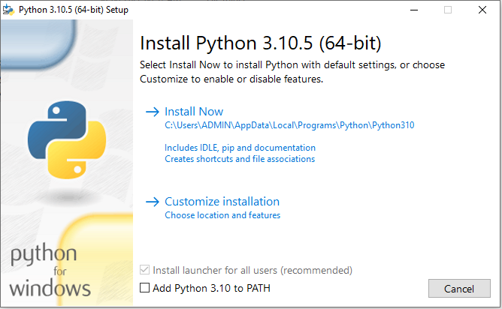
Step 1

Slide 4
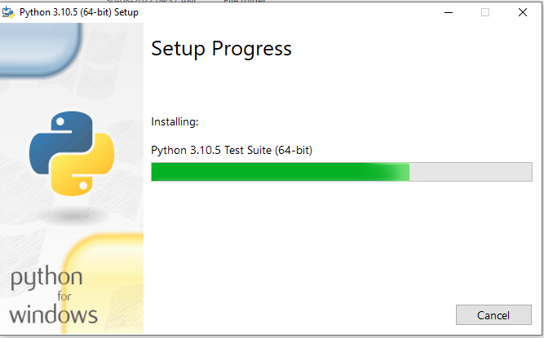
Step 2

Slide 5
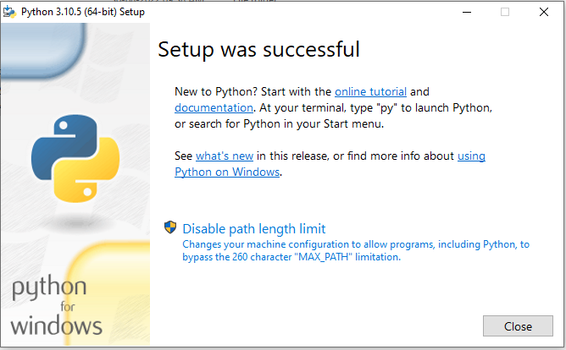
Step 3

Slide 6
Installation of Pycharm
Open the following link:
https://www.jetbrains.com/pycharm/download/#section=windows
Download the Community Edition

Slide 7
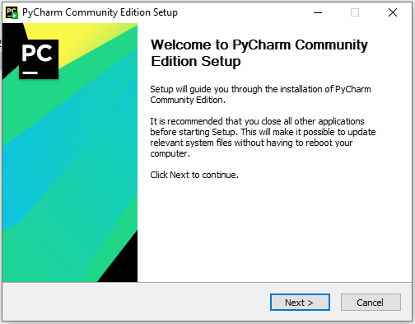
Step 1

Slide 8
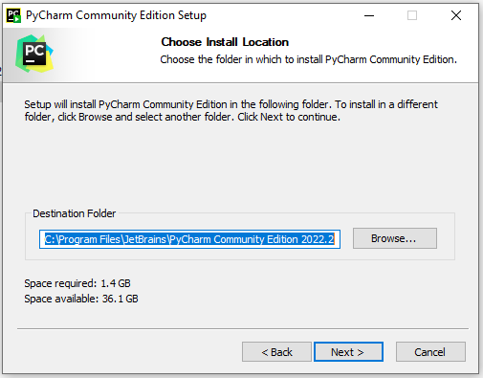
Step 2

Slide 9
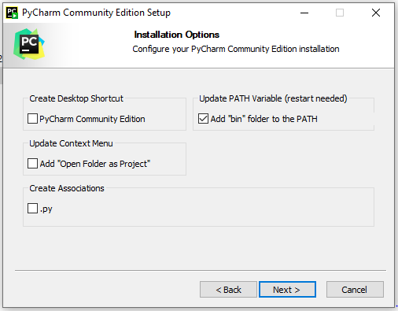
Step 3

Slide 10
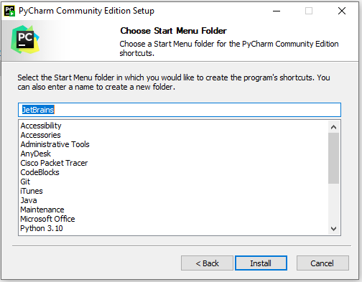
Step 4

Slide 11
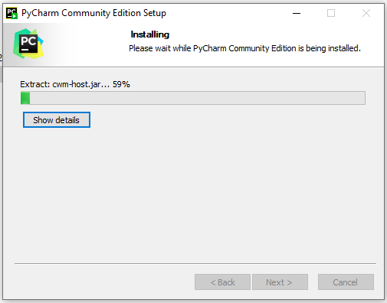
Step 5

Slide 12
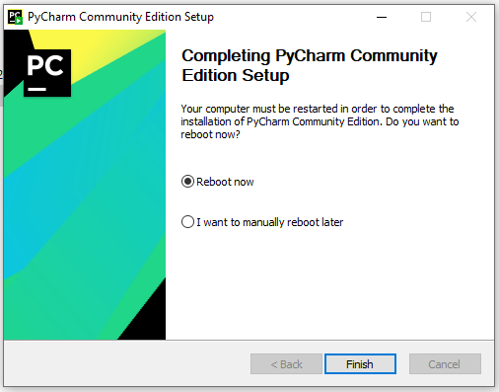
Step 6

